Slide 1

DONDONDONKI CASHIER SIMULATION
DonDonDonki Cashiers
IE3110R Simulation
Self-service or Counters or both?
IE3110R B1-A
Low Eeron (A0216716E),
Muhammad Imtiyaaz B M A M (A0216752E),
Mohamed Amirul Bin Mohamaed Amidun (A0216944Y)
Chen YingLing (A0221681L),
Cai XuanXuan (A0220596A)
Notes:
Hello, Professor and TAs, we are group B1-A and we are presenting a Simulation Model project of DonDonDonki Cashiers at Suntec City. I am Amirul and my group members are Imtiyaaz, Ying Ling, Xuan Xuan and our group leader, Eeron.

Slide 2
DONDONDONKI CASHIER SIMULATION
1
4
Model Translation
Problem Formulation & Objective
5
2
Verification & Validation
Model Conceptualization
6
Experiment Design, Runs & Output Analysis
3
Data Collection & Input Analysis
Conclusion
7
IE3110R
TABLE OF CONTENTS
Notes:
I will be talking about the problem formulation & Objective, Xuan Xuan will be covering model conceptualization, Eeron will be presenting Data Collection & Analysis, Imtiyaaz will be explain our model translation, verification and validation and finally Yingling will run through the exp design, runs, the output analysis and finish us up with the conclusion.

Slide 3

01
PROBLEM FORMULATION & OBJECTIVE
IE3110R
I’m waiting in this queue for too long!
No. of Cashiers
Avg Service time
Arrival times of customers
Avg Waiting time
Total No. of Customers in Store (Not in Queue)
Main Aim: Improve length and waiting times at DonDonDonki queues by at least 50%
In scope
Not in scope
Plan: Collect, Model, Test & Verify, Suggest
Notes:
Our team observed Japanese supermarket, DonDonDonki and realised that the Q length and waiting time to be very long during dinner time. Since DonDonDonki is very popular, the single Q, multiple cashiers system tends to hold more than 15 people and waiting times can drag up to 10 mins.
Hence, with approval from the manager, our team aims to improve the length and waiting times at DDK by at least 50% so that the store can withstand the dinner crowd. We achieve this by modelling alternative queuing systems to improve on this existing one.
In this project, we are looking into No. of Cashiers, Avg Service time, Arrival times of cust & Avg waiting times in Q. We are not concerned about the total no. of customers in the store bcos not all cust. enter the Q.
How we execute this project is by collecting data of the parameters in green of DDK and other supermarkets w Self-service counters, use the data to model the system, testing and verifying our models with said manager and statistically and finally suggesting the alternative queuing systems that best to facilitate the dinner rush in DDK.
I will now pass my time to Xuan Xuan with model conceptualization.

Slide 4
02
Model Conceptualization
Our Assumptions
Distribution
Probability
IE3110R
70% of self-checkout
30% of manual counter
10% delay for Self-checkout
Delays in walking is accounted in service time
Same Service time distribution
Same Inter-arrival time distribution
Notes:
●Thank you Amirul.
●For this project, we have made a few assumptions.
●Firstly, for the distribution [CLICK], we have assumed that all 8 counters at Don Don Donki have the [CLICK] same service time distribution. We also assumed that the original model and the optimised model have the [CLICK] same inter-arrival time distribution. These distributions are based on what we generated in the FlexSim with the raw data
●In terms of [CLICK] probability, we assumed that [CLICK] 70% of customers will go to self-check-out and [CLICK] 30% will go to the manual counter for the optimised model. [CLICK] We have also assumed that there is a 10% delay for self-checkouts. These two probability assumptions will be further justified by Yingling. [CLICK] Lastly, the delays in walking to the counters are assumed to be accounted for in the service time. [CLICK]
.

Slide 5
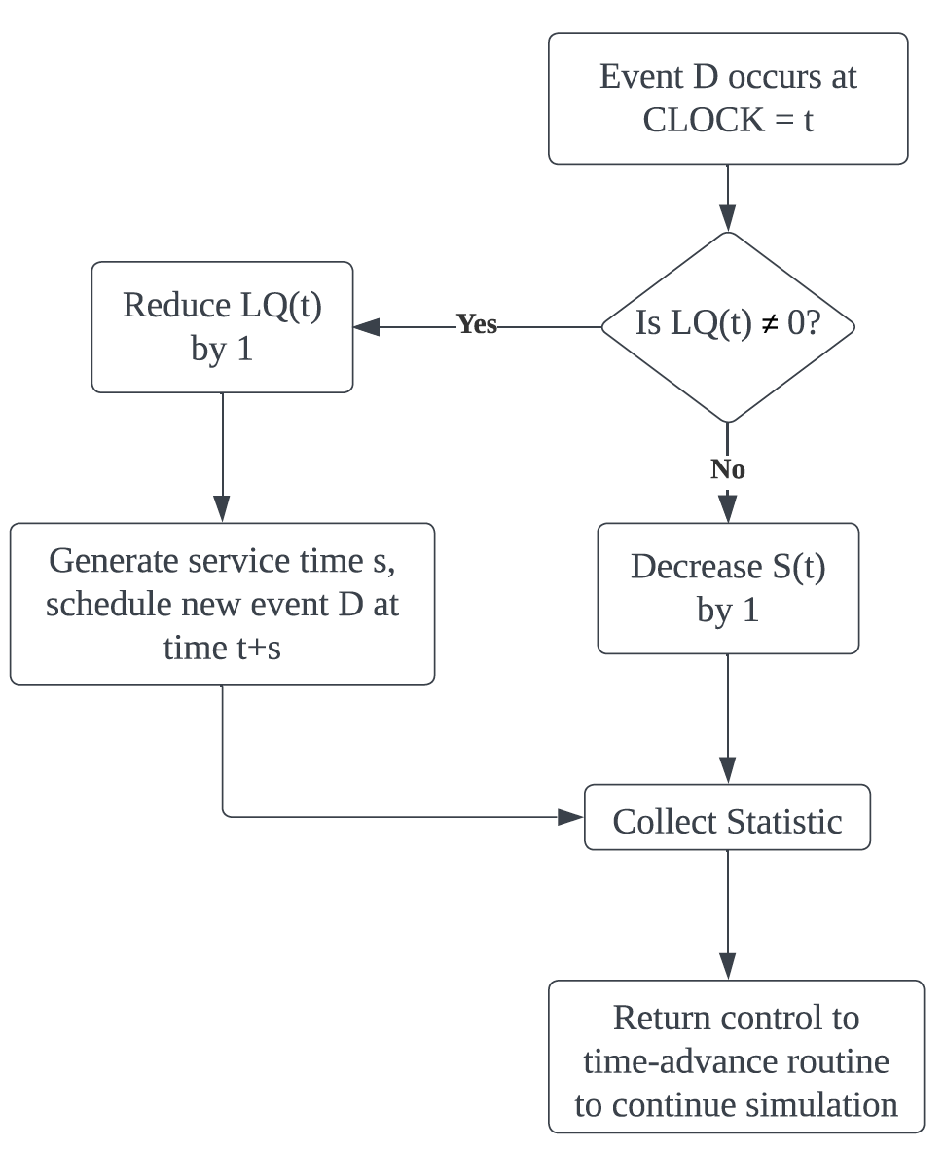
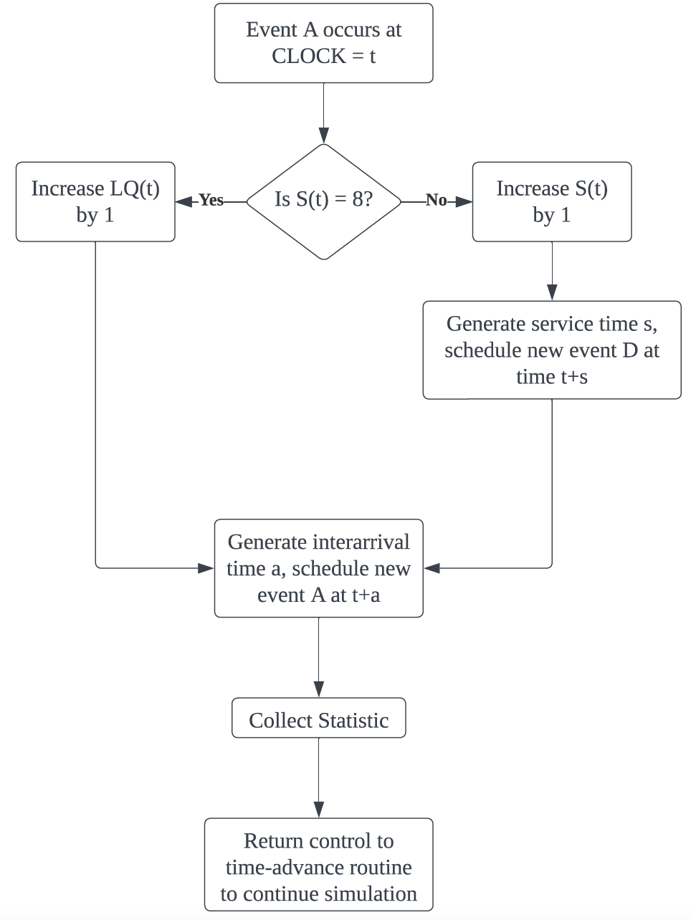
02
Model Conceptualization
System Flow
IE3110R
State Variables
Entities
Number of people in Queue
Server Status
1. Customers
2. Servers
Notes:
●To better conceptualise the model, [CLICK] we have defined two state variables which are [CLICK] the number of people in the queue and [CLICK] the server status.
●Also, [CLICK] there are two entities in our system which are [CLICK] customers and [CLICK] servers.
●The first event of the system is [CLICK] the arrival of customers where he will check if any of the 8 counters are available. If it is free, he will immediately go to the counter. If not, he will join the queue. Whenever an arrival happens, the system will schedule a new arrival event.
●The second event in the system [CLICK] is the departure of customers, when a customer departs from the system, there will a counter becomes available. If there is a queue, the first person in the queue will go to the available counter and a new departure event will be generated. If not, the server status will change from busy to idle.
●Now, I will pass the time to Eeron.

Slide 6
03
DATA COLLECTION & ANALYSIS
Data collection
IE3110R
Data will be collected at Don Don Donki and FairPrice between 6pm to 8pm over period of 3 days
Data to be collected :
-Arrival time of customers into the queue
-Departure time of customers from the queue
-Service time at checkout stations (normal and self-checkout from FairPrice)
Derive variables:
Inter-arrival= arrival time(s)-arrival time (s-1), s{2,.., infinity}
Waiting time= departure time of customers from queue - arrival time of customers into the queue.
Notes:
Thank you xuan xuan, now i will be talking about how we go about collecting data.
We will be collecting data from don don donki and fairprice between 6-8 pm for 3 days [Click].Data to be collected[Click] includes [Click]arrival time of customers,[Click]departure time of customers from the queue and [Click]service time at checkout stations. From these data[Click], we would derive [Click]interarrival time by computing the time difference between each arrived customers and derive [Click]waiting time by calculating the difference between departure time of customers from queue and their arrival time.

Slide 7
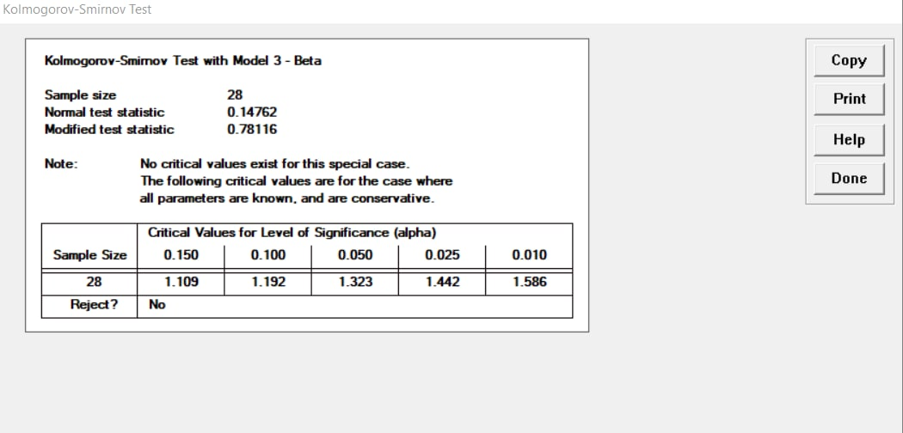
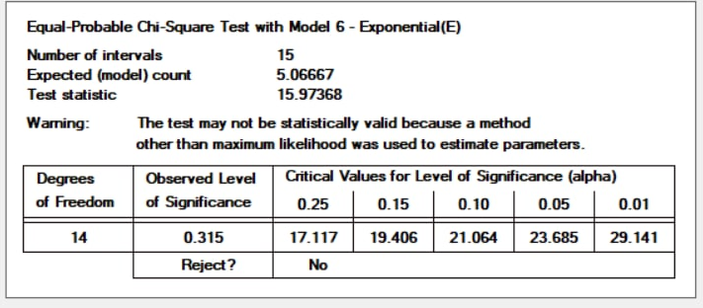
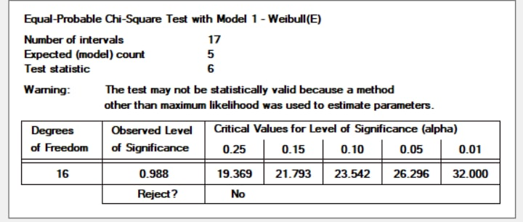
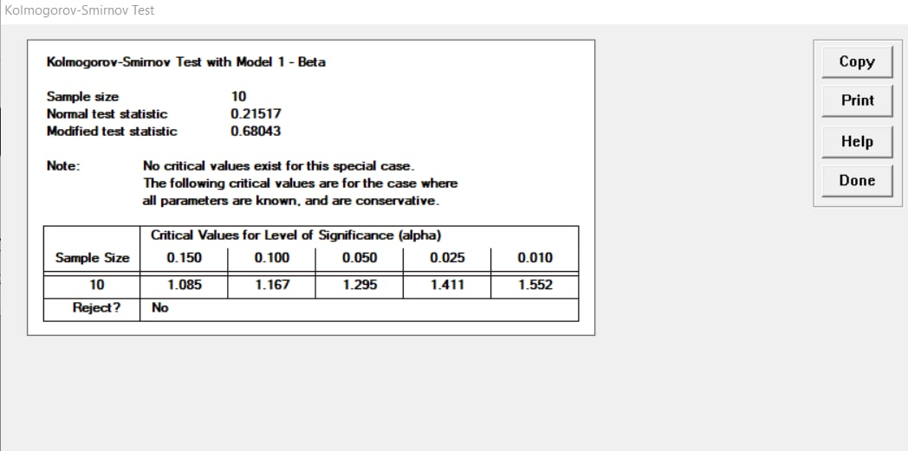
03
DATA COLLECTION & ANALYSIS
Analysis
IE3110R
Data collection (Raw)
Identifying underlying statistical distribution
Estimating the parameters
Testing for goodness-of -fit
Self-checkout no delay
Inter-arrival
Normal counter
self-checkout with delay (technical problems )
Notes:
After collecting the data and getting the derived variables, we then went to use expertfit to identify the most appropriate statistical distribution and did a goodness of fit test. As seen from the pictures above, all their respective distribution has no rejection.
Next imtiyaaz will talk about model translation

Slide 8
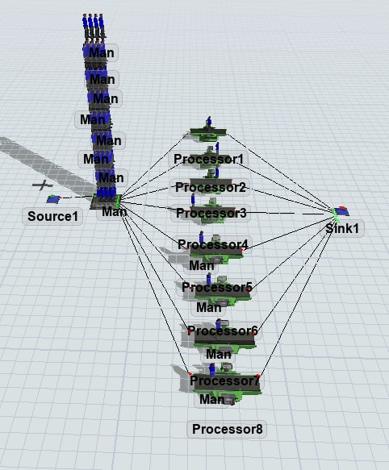
04
Model Translation
IE3110R
Source - Arrival of customer at Don Don Donki
Humans - Represents the customers in Don Don Donki
Queue - Customers waiting in the queue
Processors - Servers at Don Don Donki
Sink - Customers leaving Don Don Donki
Stacks of people in queue showcasing them waiting for the next available server

Slide 9

05
VERIFICATION & VALIDATION
IE3110R
Sim Modelled: Don Don Donki with 8 Normal Human Servers
Key Components to be Verified:
Queue Length & Waiting time in Queue for Model
“Yes, the average Waiting time usually at least 10 mins”
Store Manager
Queue Length | Waiting time in Queue
34.87 | 767.29 seconds (13 mins)
“Queue length often times get very long as it wraps around the store. 30+ customers in line have happened before when we only have a few counters open.”

Slide 10
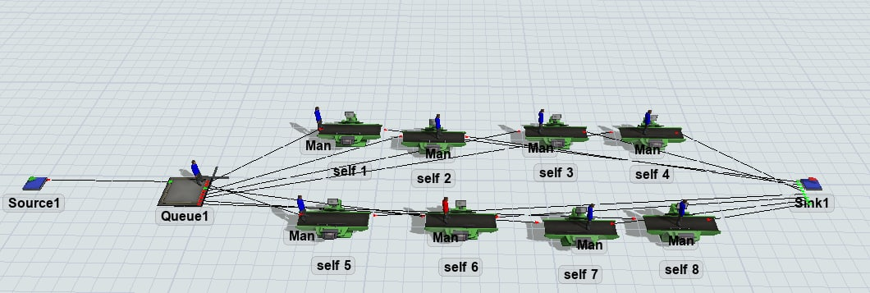
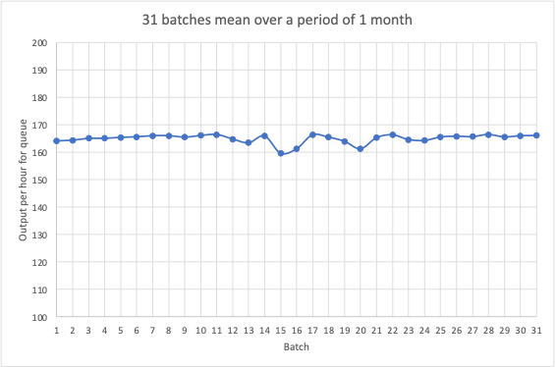
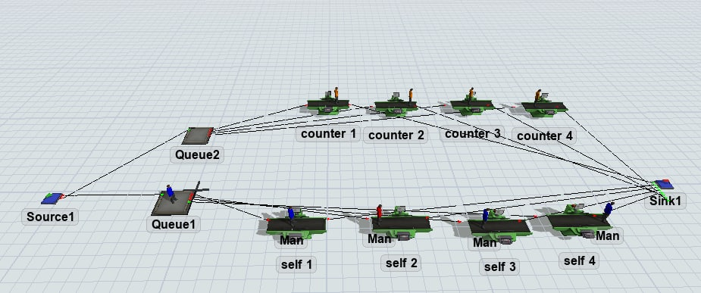
06
Experimental Design, Runs, and Output Analysis
Simulation Result
IE3110R
Full self-Service
8 Self-service machines
10% delay for self-service processing
Non - terminating simulation
10 replications
Each with 31 batches (31 days)
In steady state, no warm-up periods
Collected data during the most peak hours
Mixed Service
4 Self-service & 4 Counters
10% delay for self -service processing
70% choose self-service & 30% choose counters
Notes:
Thank you Imtiyaaz.
For this project, we aim to collect the steady state statistics, [Click] so the model we are running is a [Click] non-terminating simulation. We started to run the model for 31 days for the queue’s output per hour for [Click] 10 replications [Click] each with 31 batch means and conducted an ensemble average for these data. The derived result is shown in the [Click] graph which shows that the system is already in [Click] the steady state as we collected the raw data during the [Click] most peak hour at Don Don Donki in which we have applied intelligent initialization to reduce the initialization bias. Hence, there is no warm-up period for our system.
In order to optimise the queuing system, we suggested two alternatives which are the [Click] fully self-service with 8 counters and the [Click] mixed of 4 self-service and 4 manual counters. For both solutions, as mentioned by xuanxuan, we have assumed a [Click] 10% delay for [Click] self-service due to the misuse of machines which is [Click] denoted by red color man. While for mix service solution, there is [Click] 70% customers choose self-service and 30% choose manual counters where the probability is based on our observations at the FairPrice.

Slide 11
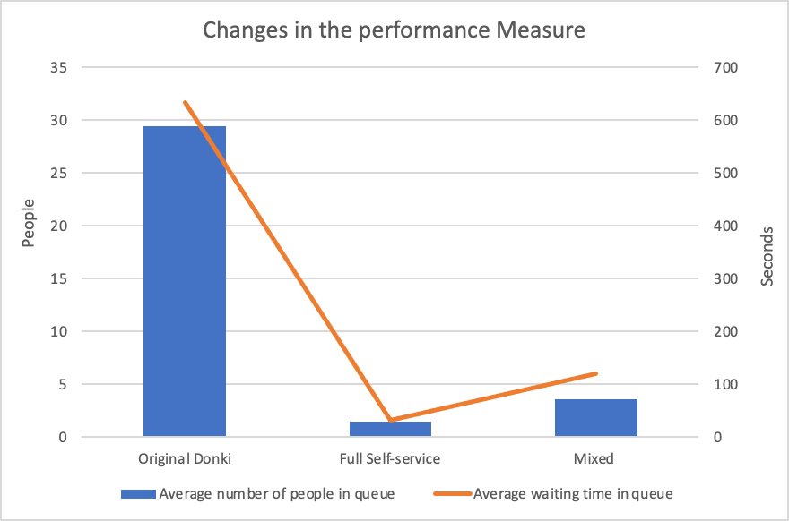
07
Conclusion
Results
Input Parameters & Performance Measure
IE3110R
 | Original Donki | Fully self-service | Mix (self) | Mix (counter)
Average Queue Length | [0, 100] | [0,20] | [0,55] | [0,15]
Average waiting time in the queue | [0, 2500] | [0,750] | [0,2500] | [0,500]
 | Fully self-service | Mix
Average Queue Length | 94.9% | 87.9%
Average waiting time in the queue | 94.8% | 81.1%
Notes:
To better compare the effectiveness of our solutions, we have identified [Click] two input parameters and performance measures which are the [Click] average queue length and the [Click] average waiting time in the queue. In terms of input parameters, we have set their respective lower bound and upper bound as shown in the table. These values are reference to the maximum and minimum values in the Flexsim of the respective models which ensures that the range is sufficiently large for the model to run.
Lastly, in terms of performance measures, both measures have [Click] reduced significantly compared to the original Don Don Donki model as shown in the graph. They have met our objective of reducing the average queue length and average waiting time in the queue [Click] by at least 50%. However, despite the fact that fully self-service counters are more efficient, our team will choose the [Click] mixed service system as the best solution as the Don Don DonkiManager said that many elderly still prefer counter service and there is a longer delay time when using the self-service counters. Hence, the mixed counter system would be a better solution when considering the personal preference into the optimising process.

Slide 12
DONDONDONKI CASHIER SIMULATION
Thank You !
IE3110R Simulation
Notes:
I have come to the end of our presentation. Thank you

Slide 13
Appendix - 1. Problem Formulation
What is the problem statement?
Don Don Donki tends to be crowded during dinner time (between 6 to 8 pm) and this causes the waiting time in the queue to be long. The issue stems from having a single queue, multiple server system which is very inefficient.
Is the problem statement provided by the stakeholders? If yes, is the problem clearly understood?
No, the problem statement is provided by the project team.
If the problem statement is provided by the project team, do the stakeholders agree to this? (in our project scope, check with
the teaching assistants for suitability of problem statement)
The problem statement is provided by the project team and the team has checked with the manager at Don Don Donki. The manager has agreed that the current queuing system is slow during peak hour.

Slide 14
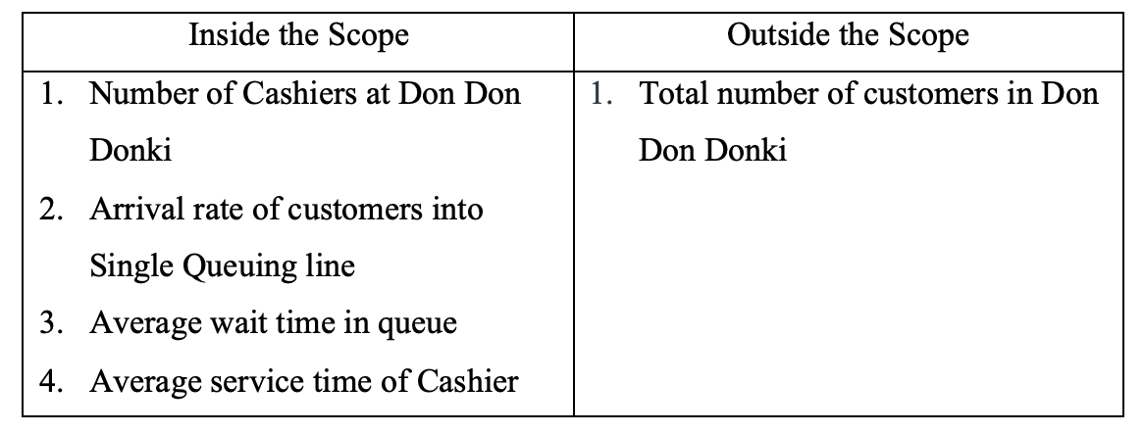
Appendix - 2. Project Objectives and Overall Plan
What is the central aim of the project?
o We aim to reduce the length and waiting time of customers in the queue by modelling the queueing system at Don Don Donki.
What is your team trying to accomplish?
o Our team is trying to reduce the length and waiting time of customers in the queue by at least 50%.
Define the boundaries of the system you are modelling. What is in scope? What is out of scope?
o Boundary: The queueing and serving system at the cashier area of Don Don Donki at Suntec City during weekdays at peak hours (6 pm to 8 pm).

Slide 15
Appendix - 2. Project Objectives and Overall Plan
Provide a summary of the general settings of the project and the overall project plan.
o First, we would collect the real-life data and create a model of the current queuing system in Don Don Donki using FlexSim.
o Second, we would verify our model based on collected data by checking with the staff and store management at Don Don Donki.
o Third, we would suggest two alternative queuing systems and model them using FlexSim based on the data we are going to collect from Fairprice.:
1. Fully self-checkout stations (8 self-checkout stations)
2. 50% self-checkout stations and 50% counters (4 self-checkout stations and 4 manual counters)
o Last, based on the alternative queuing systems, we would implement improvements to our base Don Don Donki model to make the system more efficient.

Slide 16
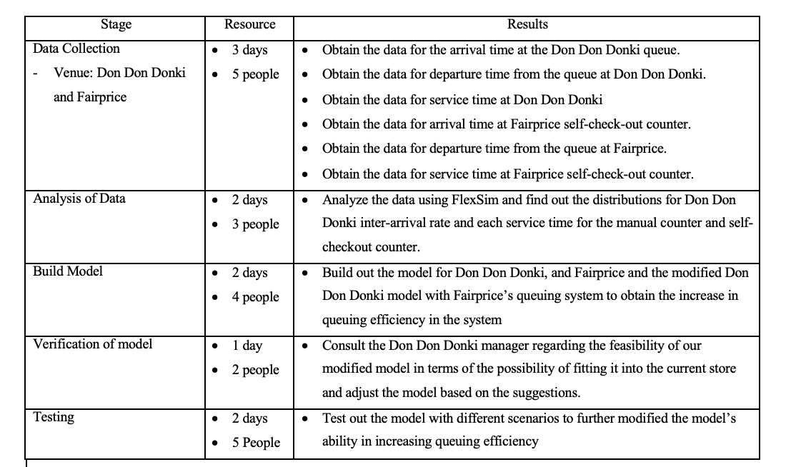
Appendix - 2. Project Objectives and Overall Plan
State the overall plan for the study with the people involved, the number of days required to accomplish each phase of the
work, and the results expected at the end of each stage.

Slide 17
Appendix - 3. Model Conceptualization
What are the assumptions of the model?
o Assumed all the self-checkout counters have the same distribution for service time.
o Assumed all the manual counters have the same distribution for service time.
o Assumed same inter-arrival time distribution for all models.
o Assumed the probability of going to the self-checkout counter is 70% and 30% for the manual counter within the same model.
o Assumed the delay in the operator’s walking is accounted into the service time when modelling the self-checkout counters.
o Assumed that there is a 10% delay for self-checkout counters due to the misuse of the machines sometimes.
What are the state variables (properties of queues, processors) in the system you are modelling?
o Number of people in the queue
o Server status
What are the entities in the system you are modelling?
o Customers
o Servers

Slide 18
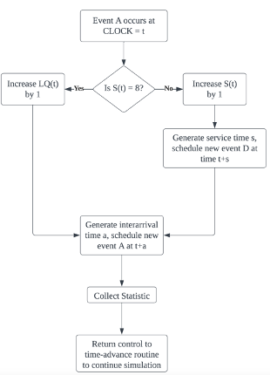
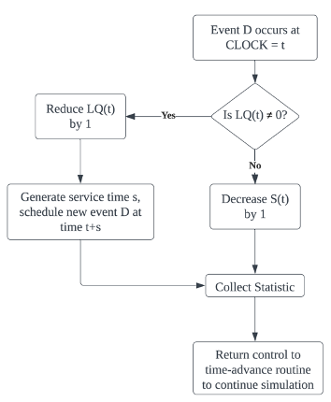
Appendix - 3. Model Conceptualization
Provide the flow charts of the system you are modelling
- States:
o LQ(t): number of customers waiting in queue, LQ(t) = {0,1,2,…}
o S(t): number of customers being served, S(t) = {1,2,3,4,5,6,7,8}
o All at simulation time t
o Events:
o A: Arrival of customers
o D: Customer ends service
o Time:
o a = interarrival time between two consecutive customers
o s = service time of all the servers

Slide 19
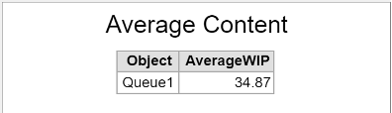
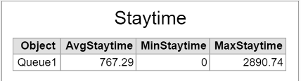
Appendix - 4. Data Collection and Input Analysis
What are the data available to be collected in the system you are studying?
o Service time
o Interarrival time
Is the data collected aligned with the objectives of the study?
o Yes, the data shows that the queue length for our base model of Don Don Donki is long during the peak hours with an average of around 30 customers in the queue. Also, the waiting time in the queue is also relatively long which is around 10 minutes. Therefore, there is a need to optimise the queuing system.
If data is not available, could the scope of the project be narrowed, or assumptions be made without affecting the overall objectives of the study?
o The data is available as the scope of the project has already been narrowed to a specific location and time.

Slide 20
Appendix - 4. Data Collection and Input Analysis
How do you plan to collect the data?
o Data will be collected at Don Don Donki and FairPrice between 6 pm to 8 pm over a period of three days.
o Data to be collected includes the arrival time of customers into the queue, departure time of customers from the queue, and service time at the checkout station (normal and self-checkout from FairPrice)
o How we collect the data:
1. Arrival time of customers: when the customer first arrives at the queue, we
record the timing of the customer. (eg. 6 pm enters the queue)
2. Departure time of customers from the queue: when the customer reaches the counter, we record his timing. (eg. 6.05pm reach the counter)
3. Service time at checkout station (normal/self-checkout): When the customer enters the checkout station, we start the timer. After the customer pays and leaves the checkout station, we stop the timer. Finally, we will record this service time.
o We then derive the different variables:
1. Inter-arrival = arrival time (s) - arrival time (s-1), s= {2,…..., infinity}
2. Waiting time = departure time of customers from the queue – arrival time of customers into the queue.

Slide 21
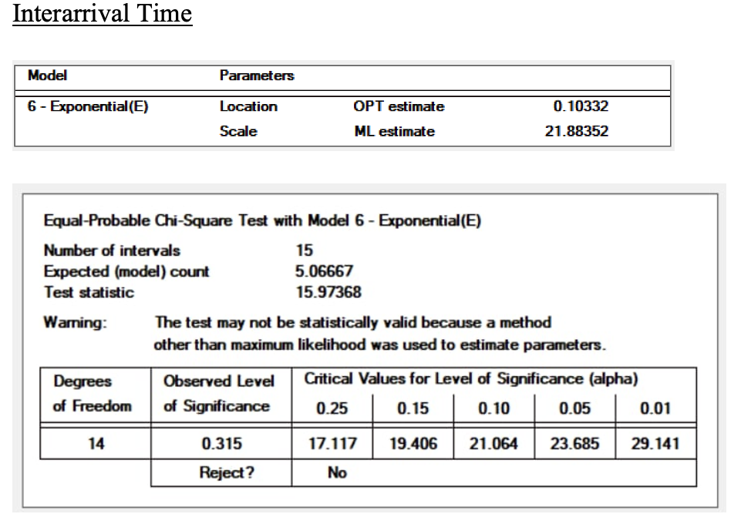
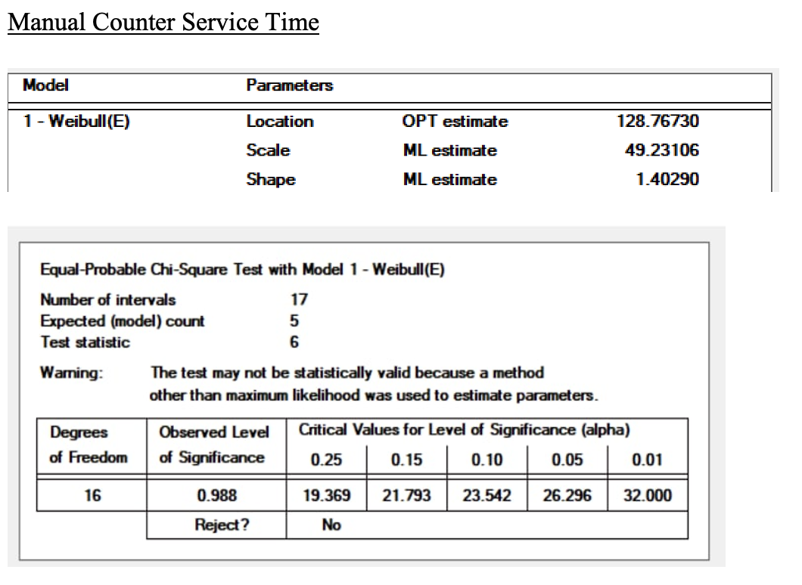
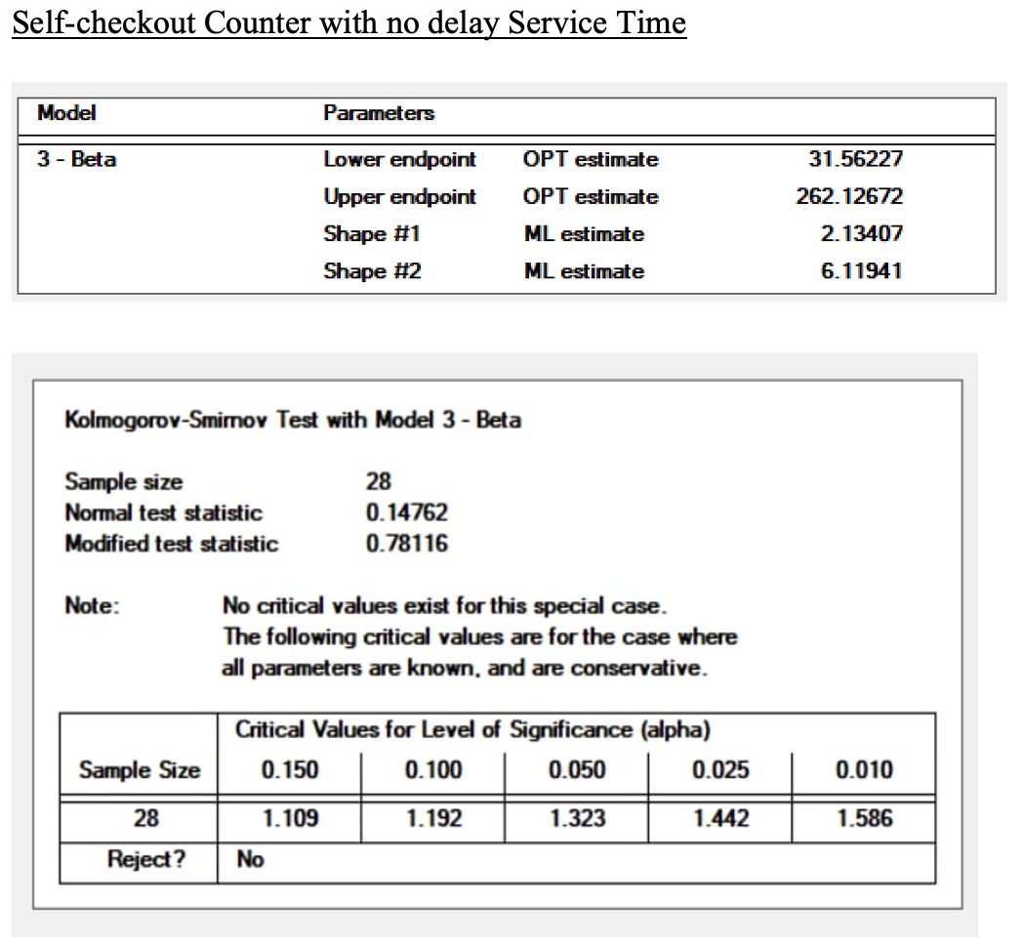
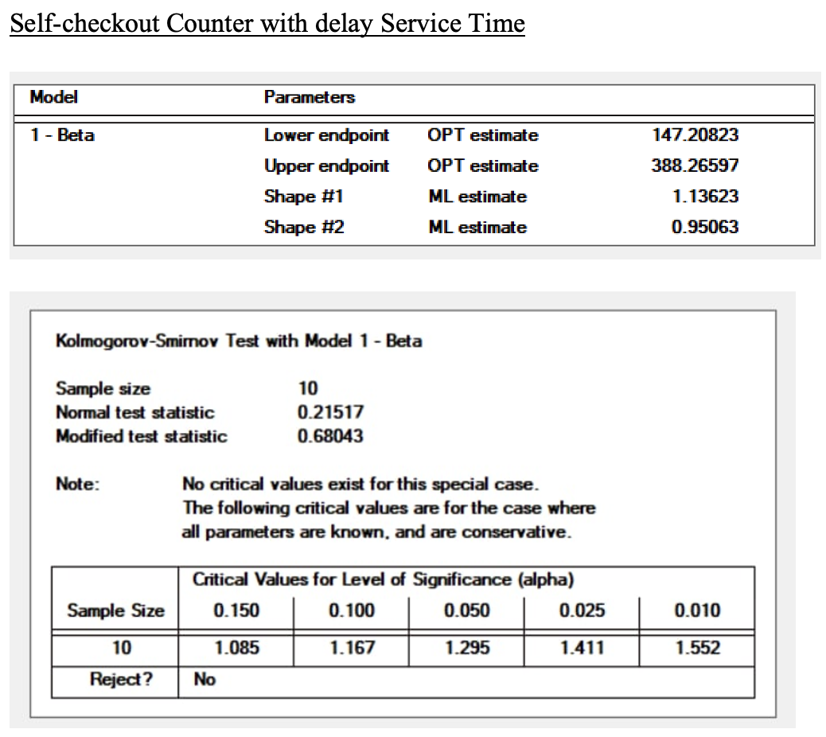
Appendix - 4. Data Collection and Input Analysis
Did you follow the steps in the development of a model of input data?
1. Data collection (Raw)
2. Identifying the underlying statistical distribution
3. Estimating the parameters
4. Testing for goodness-of-fit
o Yes, we did follow the steps in the development of a model of input data and applied Chi-Square Test and Kolmogorov-Smimov Test.

Slide 22
Appendix - 5. Model Translation
How do you plan on translating the flow charts created in Model Conceptualization to a FlexSim 3D model?
o We plan to combine all the flow charts to form a system. Based on the system, we will use the source and sink in FlexSim to build the enclosed system and use the objects in FlexSim to represent the respective entities and state variables.
How are the entities and state variables represented in FlexSim?
o ‘Human’: represents the customer.
o ‘Red colour human’: Customers who face delay when using the self-checkout counters.
o ‘Blue colour human’: Normal customers without delay.
o ‘Processor’: represents the servers.
o ‘Source’: represents the arrival of the customer.
o ‘Sink’: represents the customer leaving the system.
o ‘Queue’: represents the queue to the counters.

Slide 23
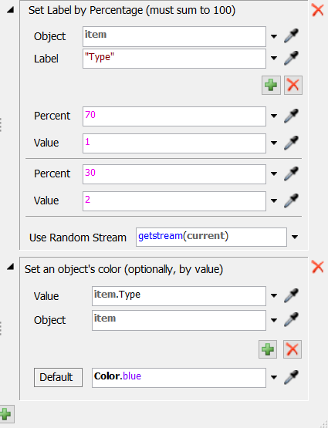
Appendix - 5. Model Translation
How do you address the branching conditions of the flow chart in FlexSim?
o There are two branching conditions in our model, and we would use the trigger function to address them.
Branching condition 1: In our mixed model (4 self-checkout counters and 4 manual counters), we assume 30% of the customers would go to manual counters and 70% of the customers would go to self-checkout counters. So we split them from the source and let them go to two separate queues, one is to the manual counters and the other one is go to the self-checkout counters.

Slide 24
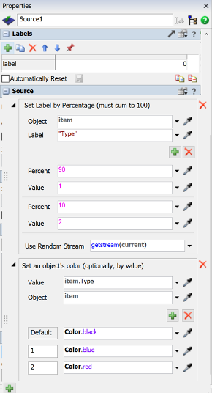
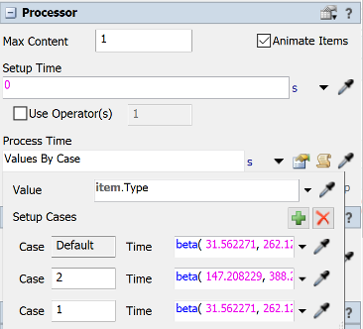
Appendix - 5. Model Translation
How do you address the branching conditions of the flow chart in FlexSim?
2. Branching condition 2: In the models with self-checkout counters, we assume 10% of the customers would encounter a delay when using the self-checkout machines and 90% would not. So we set two distribution for the service time at processors, one with the delay and one without the delay.
Could you generate random values to be used in the model based on the input analysis?
o Yes, the FlexSim will generate random values to be used in the model for the inter-arrival time and service time which are generated based on the distribution derived at the Experfit with the raw data.

Slide 25
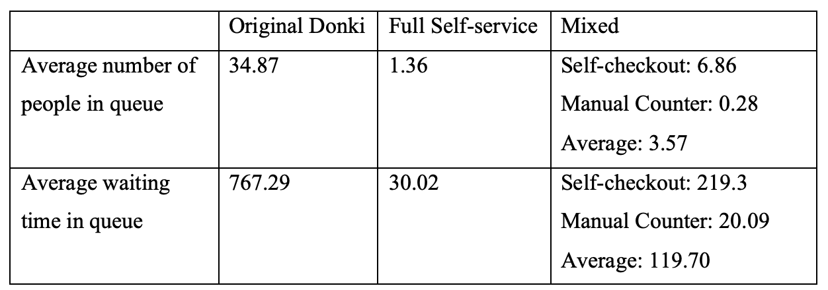
Appendix - 6. Verification
What are the key components or state variables in the model that are needed to be verified?
o The average length of the queue.
o The average waiting time in the queue.
What are the output data used to verify the model?

Slide 26
Appendix - 6. Verification
Do the output data align with the logic in the flow charts?
o Yes, it aligns with the logic in the flow chart as a new arrival event will be generate after each arrival of customers, service time will be generated after every customer enters the counter and departure event will be generated after the customers finish service, therefore it follows the flow chart.
How do you debug the model if output data does not align with the logic in the flow chart?
o We would debug using the “Event List” function under Debug to see whether each event is occurring correctly and modify our model accordingly.

Slide 27
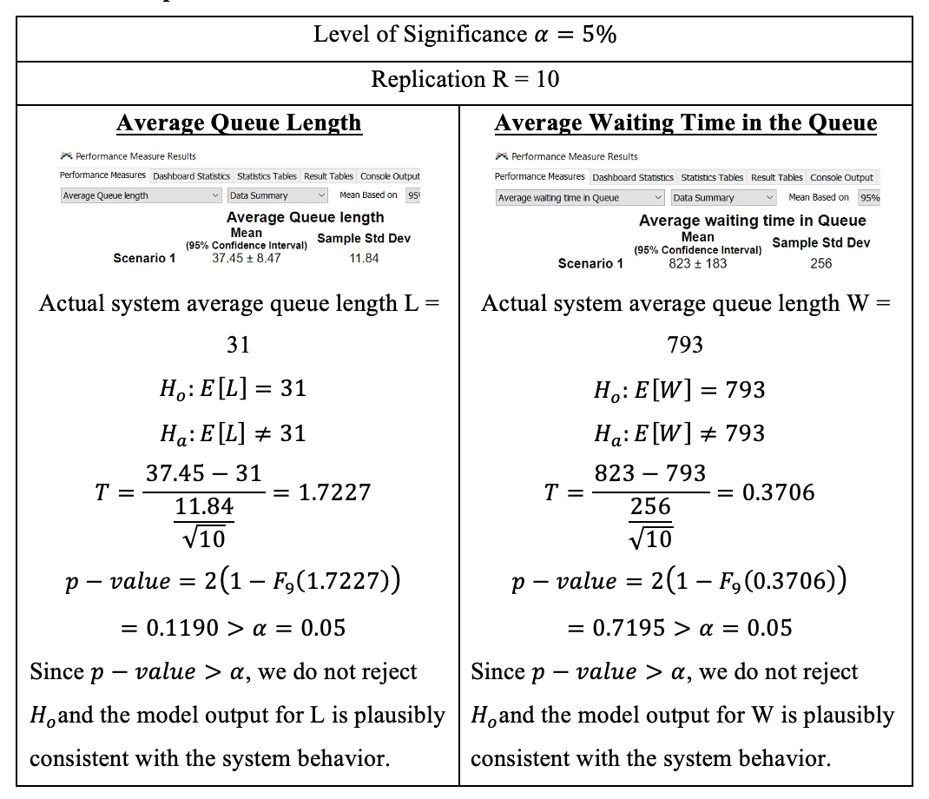
Appendix - 7. Validation
What are the performance measures that can be used to validate the model?
What are the reliable sources of information that can be used to
validate the model?
o We have consulted the Don Don Donki Store Manager at Don Don Donki Suntec City regarding the validity of our generated data.
If the model is not validated, how do u plan to calibrate the
model?
o If the model is not validated by the statistical calculation and there is no professional ideas for validation, we will recollect the raw data with more number of days to ensure that the bias is removed and the model can be validated with the T- distribution hypothesis.

Slide 28
Appendix - 8. Experimental Design, Runs, and Output Analysis
Is the simulation terminating or non-terminating?
o The simulation is non-terminating as we aim to collect the steady state statistics which are the average waiting time in the queue and the average length of the queue.
o We run the model for a long period of time which is one month and plot the batch means of 31 batches (31 days) to observe how the queue’s output changes per hour.
o From the plot, it is obvious that there is no warm-up period, and the data remain constant in a steady state at about 165 customers per hour. This is because the raw data we collected was during the peak hour of Don Don Donki and we did not include the period where there was still an increase in the number of incoming customers. As such, we have applied intelligent initialization to initialize the simulation in a state that is more representative of long-run conditions. This helps to reduce the initialization bias and hence, in our simulation, there is no warm-up period.

Slide 29
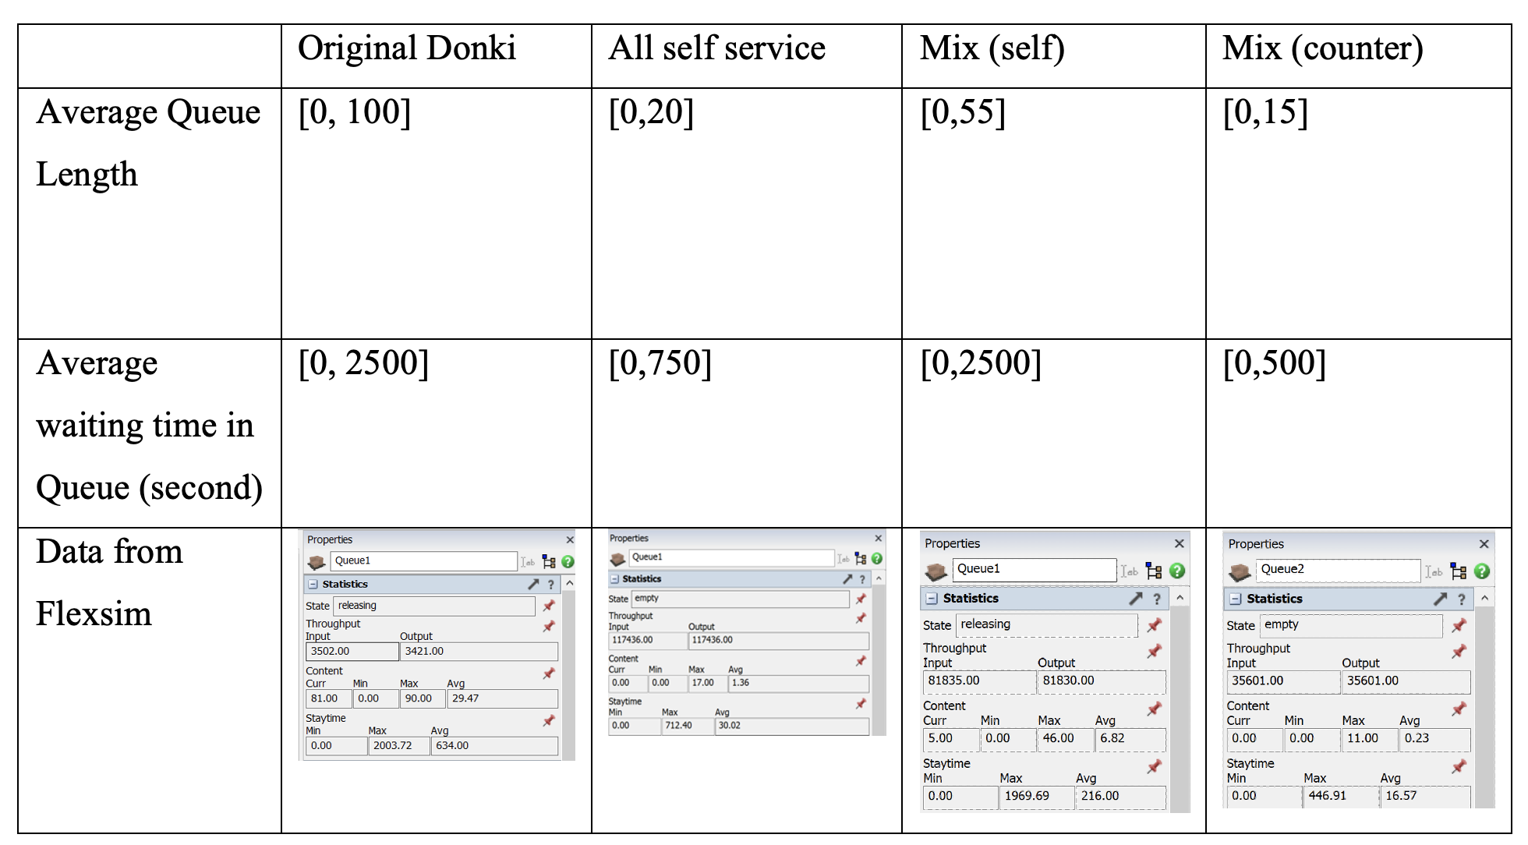
Appendix - 8. Experimental Design, Runs, and Output Analysis
What are the input parameters used for the experiments?
o Average Queue length
o Average waiting time in Queue
What are the lower and upper bound for each input parameter?
What are the performance measures of the experiments?
o Based on the average queue length and the average waiting time in queue, we would be able to know how our base Don Don Donki model and two alternative models perform. The lower the average queue length and the average waiting time in the queue, the better the results would be.
What is the number of replications for each experiment and the length of each replication?
o Each replication is 31 days
o Total 10 replications

Slide 30
Appendix - 9. Documentation
Are the processes and details well-documented in the appendices of the presentation slides?
o Yes
Are the sections above addressed in the documentation?
o Yes

Slide 31
Appendix - 10. Presentation
Are the sections above well-summarised in the presentation?
o Yes
Are the key insights and findings of the study emphasized in the presentation?
o Yes
Are the assumptions and state variables of the simulation model explained in the presentation?
o Yes
Are the input data analysis and data collection highlighted in the presentation?
o Yes
Is the experimental design well-presented?
o Yes
Are the output data analyzed and well-presented?
o Yes

